Slide 1
CHAPTER 16
Understanding Accounting and Financial Statements

Slide 2
Definition
16-<number>
Accounting is a language of business. Through accounting business communicate its activities like position and performance.
Focuses on the day-to-day flow of money in company
Finance is the management of financial resources. How to generate resources and how to invest the resources?
Management of assets and liabilities and the planning of future growth.

Slide 3
Users of Accounting Information
16-<number>
People both inside and outside and organization rely on accounting information to help them make business decisions
Accounting—practice of measuring, interpreting, and communicating financial information to support internal and external business decision making.
Accounting process records any transaction that has an implication on finance now or in future.
Notes:
Accountants measure, interpret, and communicate financial information to parties inside and outside the firm to support improved decision making.
Accountants are responsible for gathering, recording, and interpreting financial information to management.
They also provide financial information on the status and operations of the firm for evaluation by such outside parties as government agencies, stockholders, potential investors, and lenders.

Slide 4
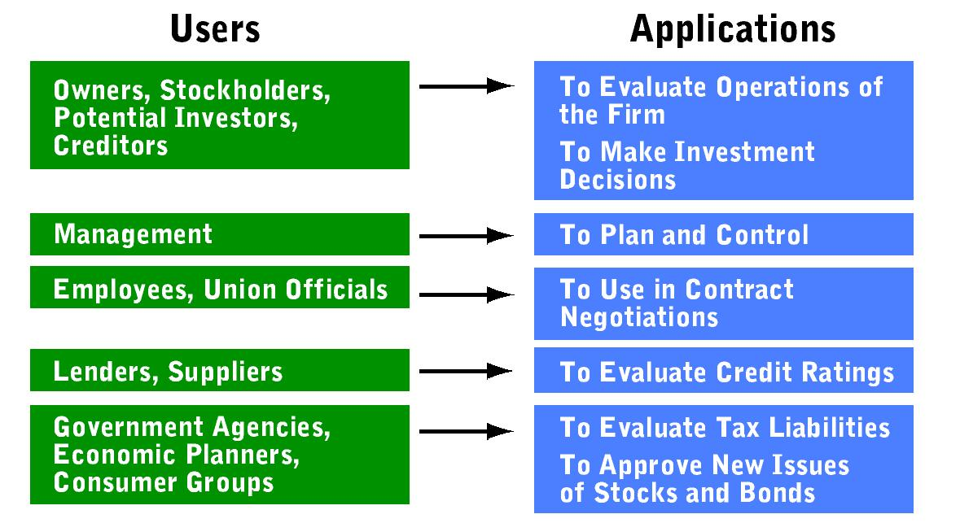
16-<number>
Users of Accounting Information
Notes:
A. People both inside and outside an organization rely on accounting information to help them make business decisions
B. Internal Users include:
1. managers within a business, government agency, or not-for-profit organizations-- helps them to plan and control daily and long-range operations
2. employees-- to understand how their work affects the bottom line
C. External Users include:
1. potential investors-- evaluate accounting information to help them to decide whether to buy its securities
2. The Internal Revenue Service (IRS) and state tax officials-- to evaluate a company’s tax payments for the year

Slide 5
Business Activities That Involve Accounting
16-<number>
Accountants contribute important information to help managers deal with the competitive and economic environments
They help others to understand, predict, and react to the technological, regulatory, and social and cultural environments
Accounting plays a key role in:
  Financing
  Investing
  Operating
Notes:
All organizations perform these three basic activities in which accounting plays a key role, including:
1. Financing activities provide necessary funds to start a business and to expand it after it begins operating.
2. Investing activities provide valuable assets required to run a business.
3. Operating activities focus on selling goods and services, but they also consider expenses an important element of sound financial management.

Slide 6
Business Activities That Involve Accounting
16-<number>
Public accountant: provides accounting services to individuals or business firms for a fee. They provide auditing, tax, advisory and consulting services.
Management accountant: accountant employed by a business other than a public accounting firm.
  Responsible for collecting and recording financial transactions, and preparing and interpreting financial statements used by the firm’s managers
Notes:
Public accountants are providers of accounting services to other firms or individuals for a fee. They are involved in such activities as tax statement preparation, management consulting, and accounting system design.
Management accountants are responsible for collecting and recording financial transactions, preparing financial statements, and interpreting them for managers in their own firms.
Management accountants frequently specialize in different aspects of accounting, including:
a. cost accountant-- determines the cost of goods and services and helps to set their prices
b. tax accountant-- works to minimize a firm’s tax bill and assumes responsibility for its federal, state, country, and city tax returns
c. internal auditor-- examines the firm’s financial practices to ensure that records include accurate data and that its operations comply with federal, state, and local laws and regulations

Slide 7
Business Activities That Involve Accounting
16-<number>
Government and Not-for-Profit accountants—work for federal, state, and local governments or not-for-profit organizations—perform professional services similar to those of management accountants
  Instead of an emphasis on measuring profit or loss, they concern themselves with determining how efficiently the organizations accomplish their objectives

Slide 8
The Accounting Process
16-<number>
Accounting Process—set of activities involved in converting information about individual transactions into financial statements.
Notes:
A. Accounting deals with financial transactions between a firm and its employees, customers, suppliers, owners, bankers, and various government agencies.
B. The procedural cycle in which accountants convert data about individual transactions to financial statements is called the accounting process.

Slide 9
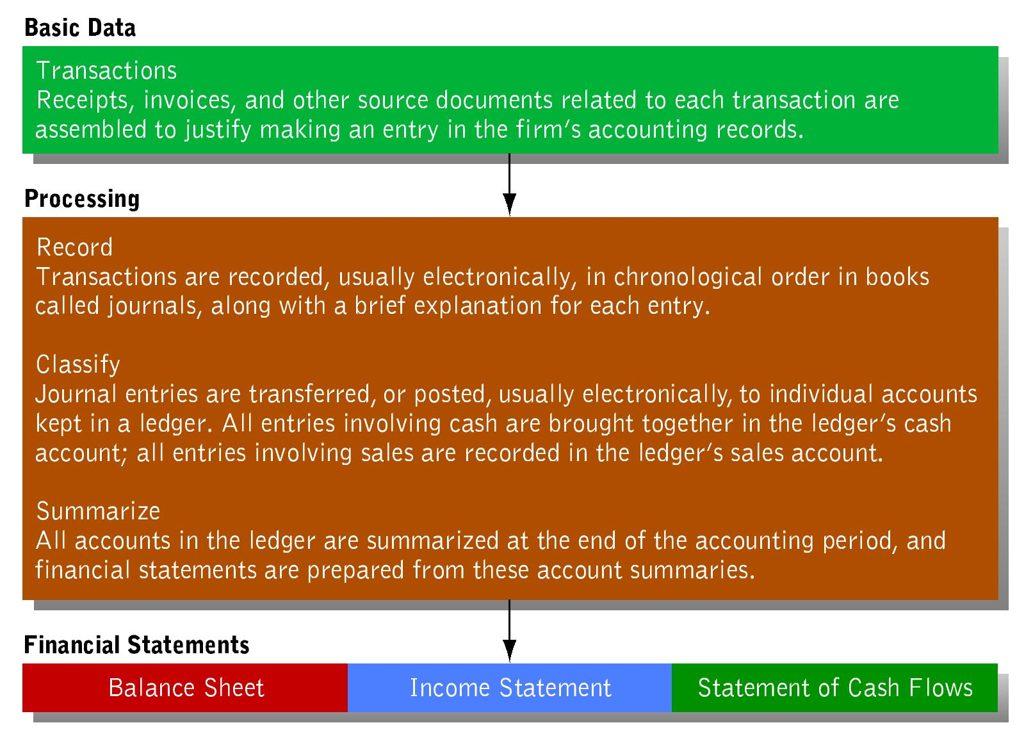
16-<number>
The Accounting Process

Slide 10
The Accounting Process
16-<number>
The Foundation of the Accounting System
  Generally Accepted Accounting Principles (GAAP)—guidelines, or standards, that accountants follow to provide reliable, consistent, and unbiased information to decision makers
  Financial Accounting Standards Board (FASB)—responsible for evaluating, setting, or modifying the GAAP

Slide 11
The Accounting Process
16-<number>
The Accounting Equation
  Asset—anything of value owned or leased by a business.
  Liability—claim against a firms assets by a creditor.
  Owner’s equity—all claims of the proprietor, partners, or stockholders, against the assets of a firm, equal to the excess of assets over liabilities.

Slide 12
The Accounting Process
16-<number>
The Accounting Equation
  Relationship that states that assets equal liabilities plus owner’s equity.
Assets = Liabilities + Owner’s Equity

Slide 13
Financial Statements
16-<number>
The Balance Sheet
  Balance sheet—statement of a firm’s financial position - what it owns and the claims against its assets - at a particular point in time.
    Similar to a photograph of the firm’s assets together with its liabilities and owners’ equity at a specific moment in time
Notes:
Financial statements provide managers with essential information they need to evaluate the liquidity position of an organization - its ability to meet current obligations and needs by converting assets into cash, the firm’s profitability, and its overall financial health.

Slide 14
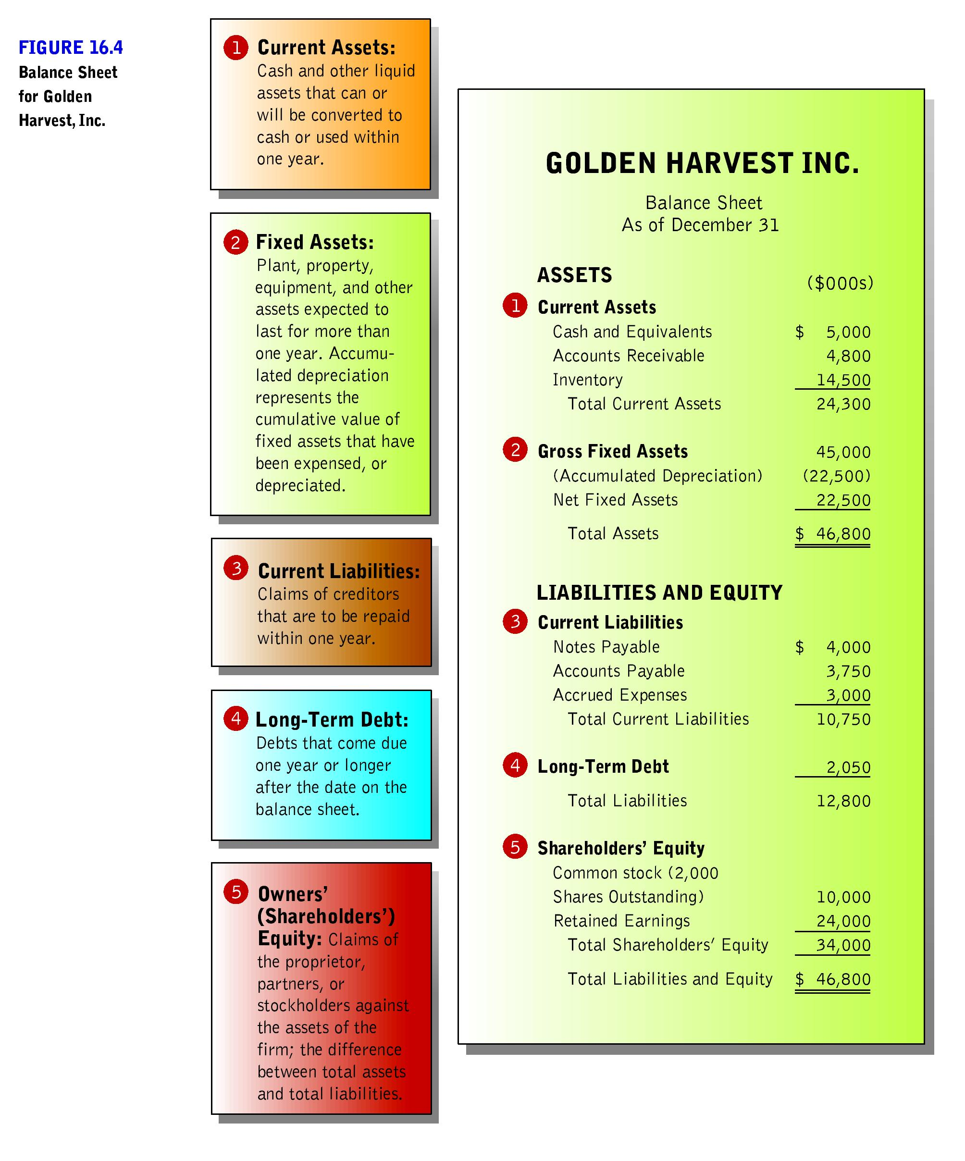
16-<number>
Notes:
The Balance Sheet
1. A firm’s balance sheet shows its financial position on a particular date, and is similar to a photograph of the firm’s assets, together with its liabilities and owners’ equity at a specific moment in time.
2. Must be prepared at regular intervals, since a firm’s managers and other internal parties often request this information every day, week, or at least every month
3. Follows the accounting equation - on the left side are the firm’s assets; on the right side are the claims against the firm’s assets
4. Liabilities and owner’s equity indicate the sources of the firm’s assets and are listed in the order in which they are due

Slide 15
16-<number>

Slide 16
Financial Statements
16-<number>
The Income Statement
  Financial record of a company’s revenues, expenses, and profits over a period of time.

Slide 17
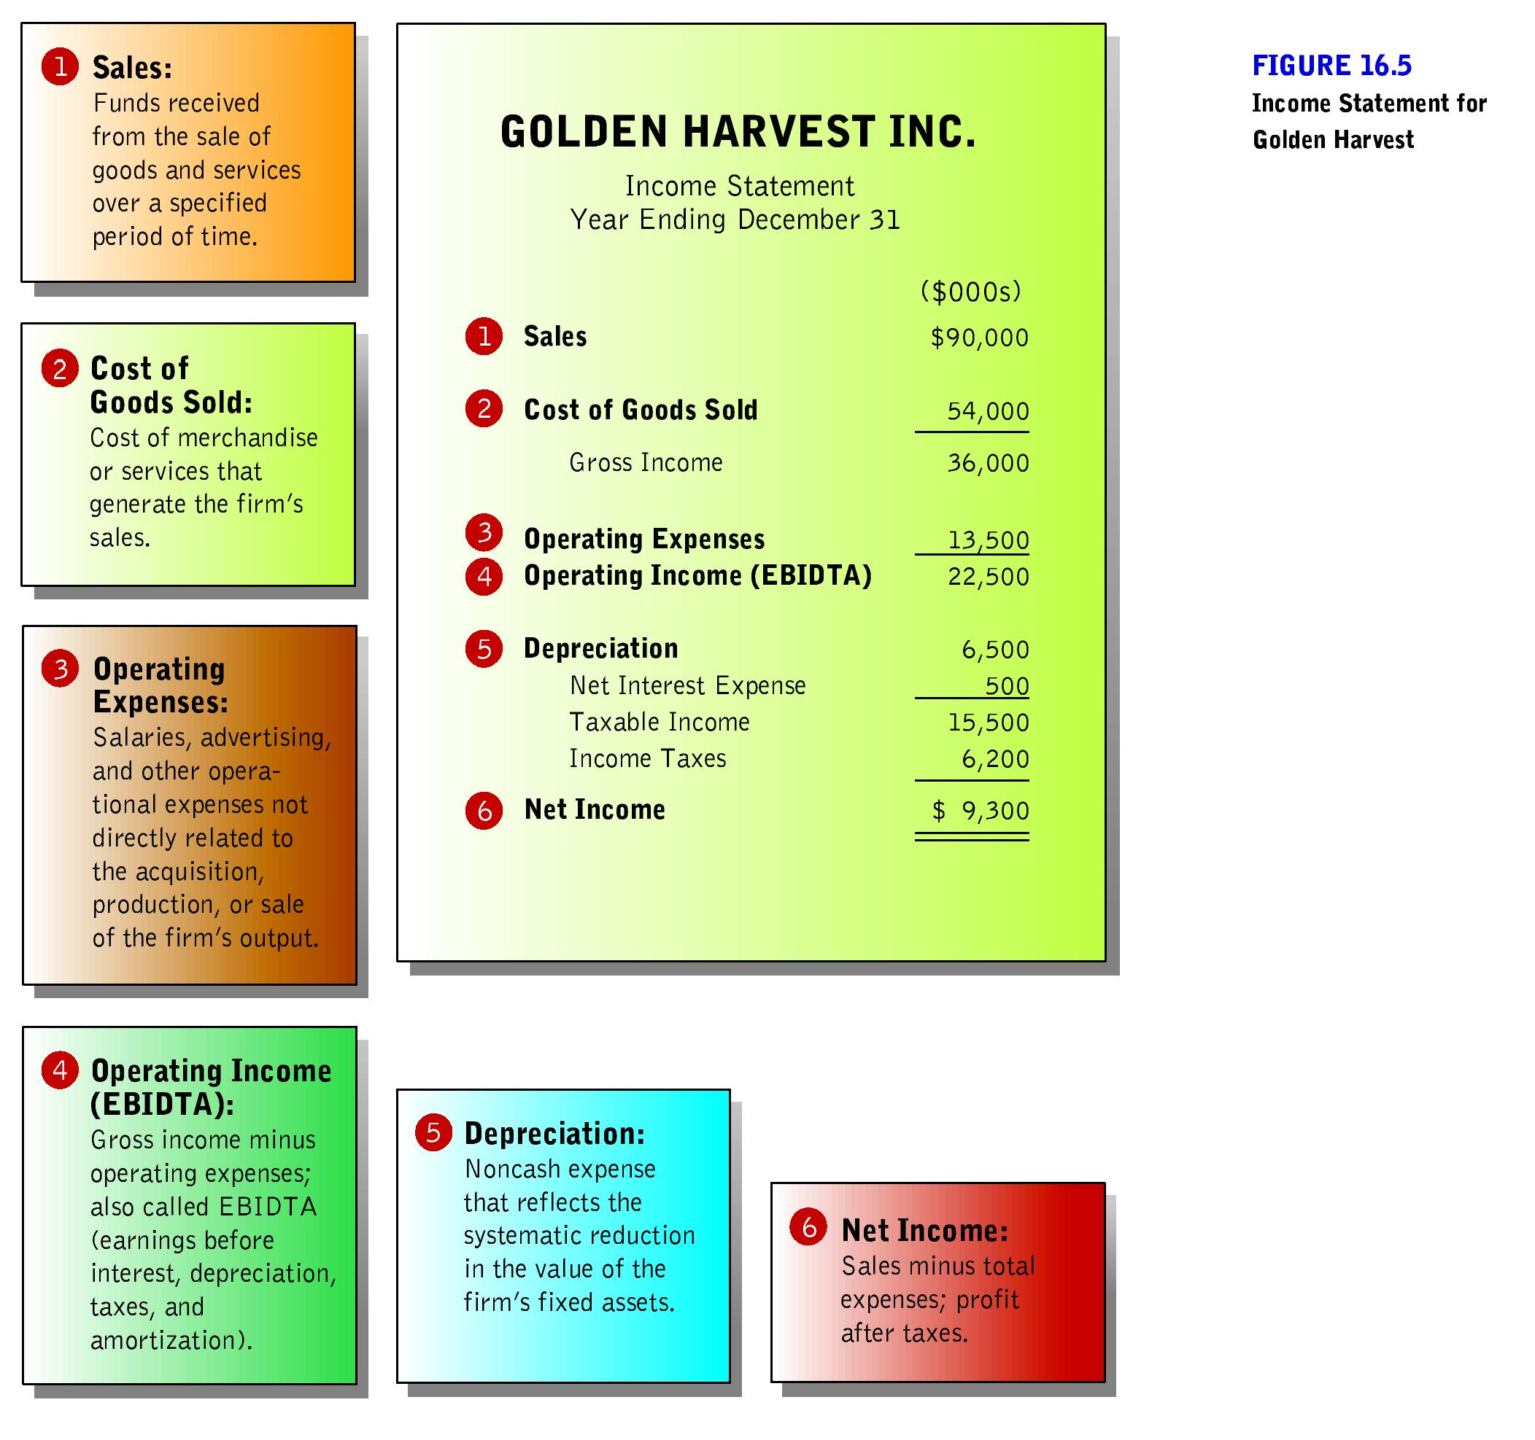
16-<number>
Notes:
The Income Statement
1. Is a financial record summarizing a firm’s financial performance in terms of revenues, expenses, and profits over a given time period
2. Reports the firm’s profit or loss results
3. Helps decision makers to focus on overall revenues and the costs involved in generating these revenues
4. Provides much of the basic data needed to calculate the financial ratios managers use in planning and controlling activities
5. Sometimes called a profit and loss, or P&L statement, begins with total sales or revenues generated during a year, quarter, or month
6. The final figure on the income statement - net income after taxes - is the well known bottom line

Slide 18
Financial Statements
16-<number>
The Statement of Cash Flows
  Statement of a firm’s cash receipt and cash payments that presents information on its sources and uses of cash.
    Accrual accounting—accounting method that records revenue and expenses when they occur, not necessarily, when cash actually changes hands.

Slide 19
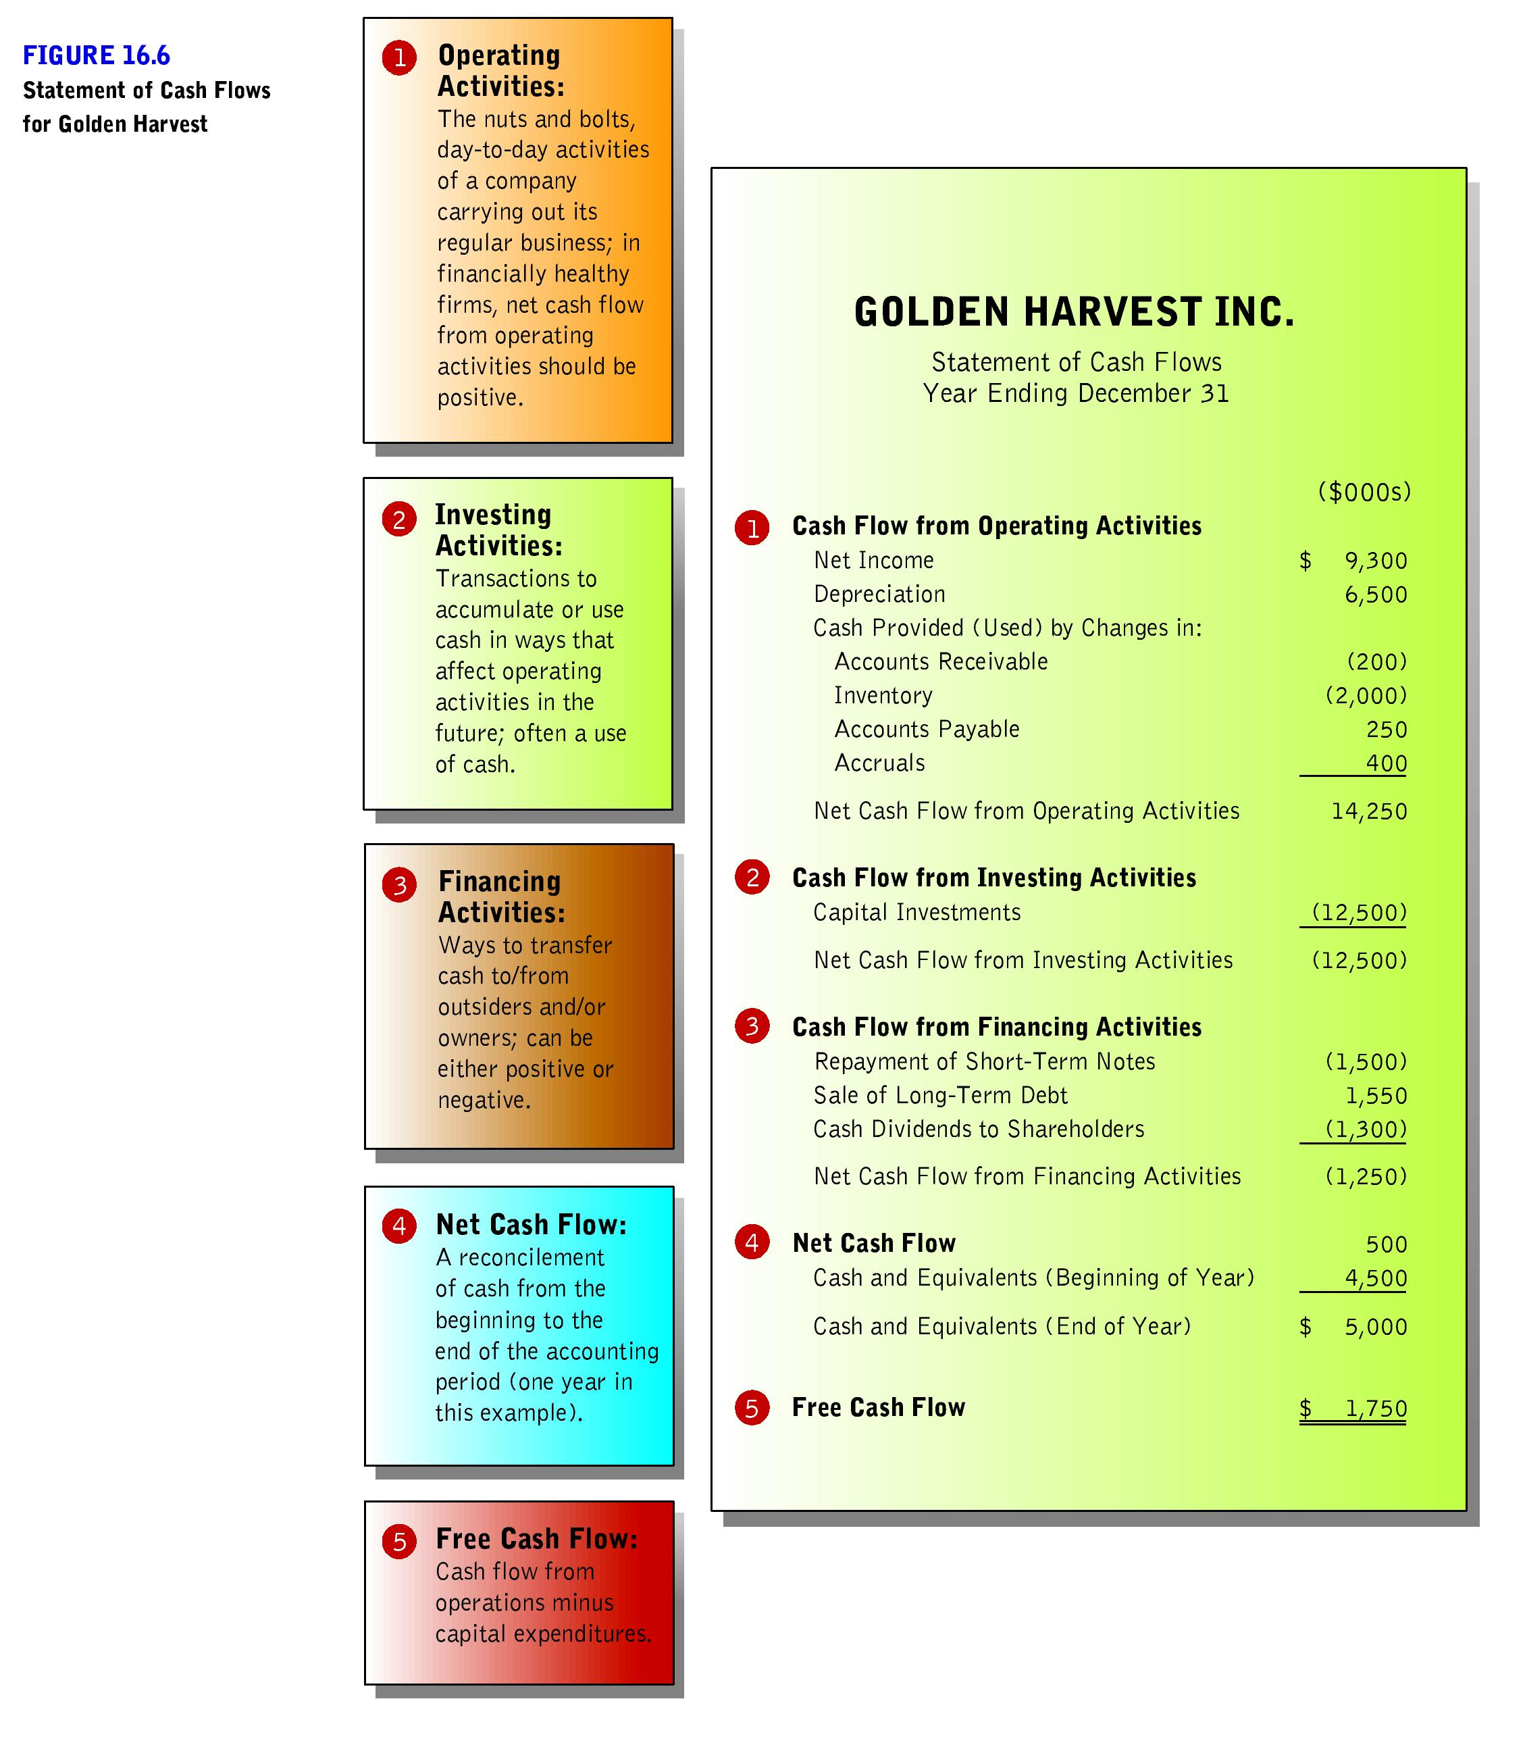
16-<number>
Notes:
The Statement of Cash Flows
1. Provides investors and creditors with relevant information about a firm’s cash receipts and cash payments for its operations, investments, and financing during an accounting period.
2. Companies often prepare this due to the widespread use of accrual accounting - recognizes revenues and costs when they occur, not when actual cash changes hands.

Slide 20
Financial Ratio Analysis
16-<number>
Ratio analysis—one of the most commonly used tools for measuring the firm’s liquidity, profitability, and reliance on debt financing, as well as the effectiveness of management’s use of its resources
  Allows comparisons with other firms and with the firm’s own past performance

Slide 21
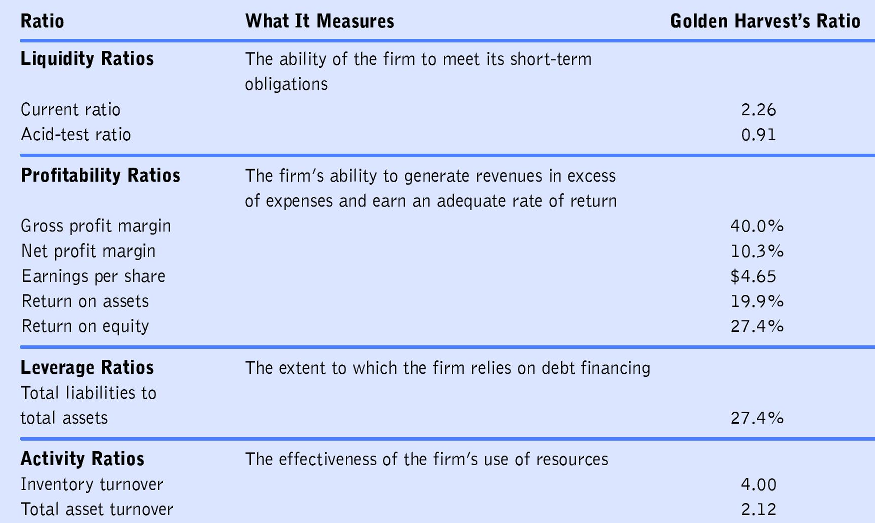
Financial Ratio Analysis
16-<number>
Financial Ratios and What They Measure

Slide 22


Activity Ratios
Net sales
Inventory turnover ratio indicates the number of times merchandise moves through a business.
Average of inventory
Net sales
Total asset turnover ratio indicates how much in sales each dollar invested in assets generates.
Average of total assets
Notes:
Activity ratios measure the effectiveness of management’s use of the firm’s resources. Inventory turnover rates can vary widely from industry to industry. Higher total asset turnover ratios indicate greater efficiency. The inventory ratio of 5.13 shows efficiency compared to the industry standard. Kroger has an industry standard of 11.4 and Nike has a turnover of 4.5. Inventory turnover can vary depending on the type of products.
The asset turnover of 2.15 is average compared to the ratio of 3.5 at Costco.

Slide 23

Liquidity Ratios
Total current assets
Current ratio compares current assets to current liabilities.
Total current liabilities
Acid-test (or quick) ratio measures the ability of a firm to meet its debt payments on short notice.
Cash and equivalents
+ short-term investments
+ accounts receivable
Total current liabilities
Notes:
Liquidity ratios measure a firm’s ability to meet its short-term obligations. The current ratio shows that Diane’s Java has $2.58 of current assets for every $1.00 of current liabilities. A current ratio of 2 to 1 is satisfactory. Diane’s Java acid ratio is around 1 to 1, Diane’s Java appears to have a strong level of liquidity. Ratios should be compared across periods and with other firms in the industry.

Slide 24


Profitability Ratios
Profitability ratios measure the organization’s overall financial performance by evaluating its ability to generate revenues in excess of operating costs and other expenses.
Notes:
Profitability ratios Measure the organization’s overall financial performance by evaluating its ability to generate revenues in excess of operating costs and other expenses. All of these ratios indicate positive evaluations of the current operations. Net profit indicates the firm’s profit. Net profit margins average around 5%.

Slide 25

Leverage Ratios
Leverage ratios measure the extent to which a firm relies on debt financing.
Total liabilities to total assets ratio > 50 percent indicates that a firm is relying more on borrowed money than owners’ equity.
Notes:
If management has assumed too much debt in financing the firm’s operations, problems may arise in meeting future interest payments and repaying outstanding loans.

Slide 26
Budgeting
16-<number>
Budget—a planning and controlling tool that reflects the firm’s expected sales revenues, operating expenses, and cash receipts and outlays
  Quantifies the firm’s plans for a specified future period
  Serves as a financial blueprint
  Standard for comparison against actual performance
Cash Budget
Notes:
Budget preparation is frequently a time-consuming task that involves many people from various departments within the firm.
Cash budget—identifying cash inflow and outflows for a specified time period.

Slide 27
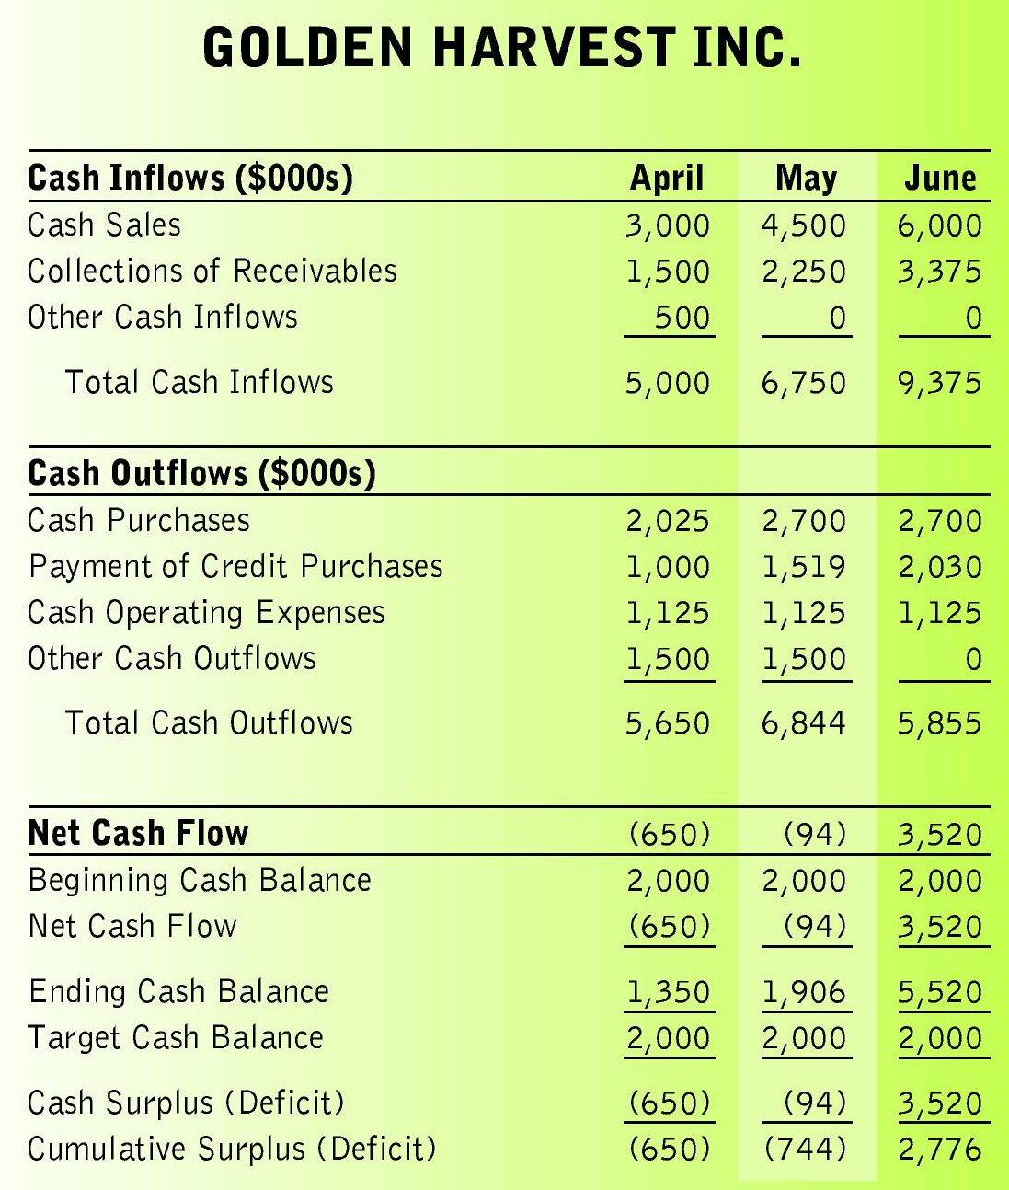
16-<number>
Three-Month Cash Budget for Golden Harvest

Slide 28
International Accounting
16-<number>
Accounting procedures and practices must be adapted to accommodate an international business environment

Slide 29
International Accounting
16-<number>
Exchange rate—the ratio at which a country’s currency can be exchanged for other currencies
  Currency prices change daily according to supply and demand
  Such fluctuations complicate accounting entries and practices

Slide 30
International Accounting
16-<number>
International Accounting Standards
  International Accounting Standards Committee (IASC), established in 1973, promotes worldwide consistency in financial reporting practices
Notes:
The IASC is recognized worldwide as the body with sole responsibility and authority to issue pronouncements on international accounting standards

